Slide 1
AIDC and OLDI: gap analysis and perspectives
Special Implementation Project
AIDC
Bangkok, 28-31 Oct. 2014
Prepared by F.Lecat

Slide 2
This analysis in 10 items
Both standards cover notification, coordination and transfer at FIR boundaries, defining messages exchanged between an upstream and a downstream Flight Data Processor : Inter-centre communications or ICC in Annex 10 vol II
Both standards (AIDC: 20 messages, OLDI: 43 messages) share a little common basis (6 out of 57 messages), plus messages being different having yet the same intention (e.g. datalink transfer)
OLDI has specified many more specific messages (37 out of 57) than AIDC (14 out of 57), due to radar operations, a more refined negotiation process, civil-military coordination, and metering between ATSU
OLDI widely used in Europe, and is a means of compliance for the COTR (COordination- TRansfer) regulation
AIDC widely used elsewhere, with ICAO urging implementation for non equipped ATS units

Slide 3
This analysis in 10 items
Industry has been providing with ATC systems for a long time embarking often the 2 standards, with different HMI design, ranging from a dedicated window to the full integration in the label
Implementation by ANSPs seems far from using all possibilities of the standards, particularly OLDI, yet…
… lessons learnt show that operations benefit from a minimal message set, reducing the likelihood of LHD occurrences and alleviating ATCO workload, and that other benefits should be sought with neighboring ATSU
Between ICAO regions: a PAN AIDC standard is being finalized, reconciliating NAT and APAC ICDs, whilst implementation of coordination at boundaries between OLDI and AIDC regions would need more guidance
A global framework for trajectory management is being developed by R&D following ICAO Global ATM Operational Concept, which should progressively supersede current AIDC and OLDI implementations and bring a seamless trajectory shared by airlines, network, ATSUs, and airports from 2020 onwards. Meanwhile any standardization of a PAN OLDI/AIDC ICD would involve costly system upgrades, out of the path to Flight and Flow Information for a Collaborative Environment (FFICE)

Slide 4
Agenda
Definition & operational scope
OLDI/AIDC messages comparison
Implementation
Regulatory considerations
Inter-ICAO regions considerations
Gap analysis result
The future
Conclusion

Slide 5
Gap analysis
A gap analysis between AIDC and OLDI is performed throughout the presentation:
  Red color is used in association with OLDI
  Grey color is used in association with AIDC
  Black color is used for the common messages/functionalities

Slide 6
Definitions, operational scope
AIDC
OLDI
AIDC- ATS Interfacility Data Communication
  Specified in Manual of Air Traffic Services Data Link Applications ICAO Doc 9694, part VI
Specification of peer to peer messages including the rules for processing, content, format
  2 message formats: ICAO Doc 4444 and ADEXP
  Standardized by Eurocontrol

Slide 7
Definitions, operational scope
AIDC
OLDI
Covers
  Notification of flights approaching a flight information region (FIR) boundary
  Coordination of boundary-crossing conditions (including reroute)
  Transfer of control
  Transfer of communications
  CIVIL/CIVIL coordination
  Transfer of information contained in an ADS-C report from one ATSU to another
Local propagation of events (between adjacent FDPs)
Covers
  Notification of flights approaching a flight information region (FIR) boundary
  Coordination of boundary-crossing conditions (including reroute)
  Transfer of control
  Transfer of communications
  Arrival management
  SSR code assignment
  Particularize an aircraft between ATSU
  Skip communications
  CIVIL/CIVIL and CIVIL/MIL coordination
Local propagation of events (between adjacent FDPs)

Slide 8
OLDI/AIDC messages comparison

Slide 9
Messages comparison
A gap analysis between AIDC and OLDI messages follows
  Common basis
  Notification, coordination, transfer
  Air/ground datalink
  Flight planning
  Civil/military coordination
  Situation awareness
  Other messages

Slide 10
Common basis
6 messages in common

Slide 11
Notification, coordination, transfer (1/2) - Core set
CORE SET of messages for Notification, coordination and transfer –Initial Purpose of AIDC and OLDI
  Essential subset of messages: its implementation brings immediate benefits for safety (reduced frequency of erroneous transfers, of Large Height Deviations, etc.) and ATCO workload reduction (phone coordinations replaced by automatic message exchanges)
  Referred to as the “core” (APAC AIDC v3) or “basic procedure” message set (OLDI v4.2) (NAT region has defined an even greater core subset)
  Its use may be largely integrated through the label in the air situation display (radar areas)
  In non radar areas, often presented in a dedicated window
  Suits simple scenarios of negotiation, else revert to/use voice communications
Gap analysis: functional equivalence between AIDC and OLDI on the essential set

Slide 12
Notification, coordination, transfer (2/2) – Non essential set
  Non essential subset of messages for coordination and transfer
    OLDI ROC and OCM are implemented between oceanic and continental centres
    Other coordination OLDI messages are refining the negotiation process: rarely implemented
    OLDI Transfer of Communications messages (COF, ROF) allow radar hand-offs and bring immediate benefits on safety and workload reduction
  Gap analysis: OLDI standard is better equipped for radar hand-offs (largely used in Europe) and refined coordination negotiations

Slide 13
In APAC: AIDC is a target for end 2015
AIDC (version 3 or later) between ATC units where transfers of control are conducted
alternate means of automated communication of ATM system track and flight plan data are employed
AIDC messages types should be implemented:
    Advanced Boundary Information (ABI);
    Coordinate Estimate (EST);
    Acceptance (ACP);
    TOC; and
    Assumption of Control (AOC).

Slide 14
Air/ground datalink
  Subset of message used for FDP cooperation to establish and release datalink connections when transferring datalink capable aircraft at a coordination point
Gap analysis: relative functional equivalence but significant differences yet:
  OLDI messages enable to handle accommodation (ATN and FANS 1/A aircraft) whilst AIDC does not convey the full ATN logon context
  AIDC is better equipped to share FANS 1/A ADS-C surveillance reports with another ATSU (e.g. in Areas of Common Interest)

Slide 15
Flight planning
AIDC TDM message used to disseminate track information
Latitude/longitude Waypoints or named en route points, allows User Preferred Routes
No equivalent in OLDI as an Initial FPL Processing System (IFPS) operated by Eurocontrol distributes initial flight plans as part of the Network function in Europe
Gap analysis: no functional equivalence for flight planning due to different operational concepts

Slide 16
Civil-military tactical coordination
OLDI includes a subset of messages for dialogue between civil and military units, not implemented in Europe to date
Different operational concepts of coordination/integration between civil and military operations exist in the world
This OLDI message subset assumes that these units
  operate distinct airspaces with crossing flights needing coordination
  operate different ground systems
Civil-military flight data exchange and airspace crossing
Gap analysis: no AIDC messages for civil-military tactical coordination

Slide 17
Situation awareness
OLDI includes a subset of messages for directing flight coordination information towards third party organizations like the provision of Flight information to military
Gap analysis: no AIDC messages standardized for flight coordination information towards third party organizations

Slide 18
Other messages
OLDI specific message (COD) for SSR code assignment to avoid wasting scarse mode A codes
OLDI specific messages (SCO/SKIP) for skipping the accepting sector in the TOC process
OLDI specific message (PNT) to particularize a flight between ATSUs (to ease coordination dialogue between ATCOs)
OLDI specific message (AMA) used for conveying the TTL/TTG budget and/or target time at the COP to maintain sequences between ATSUs
Gap analysis: no functional equivalence in AIDC for SSR code assignment, skip of communications, Point session and sequencing

Slide 19
IMPLEMENTATION

Slide 20
Implementation (1/2)
AIDC
OLDI
Worldwide implemented, except Europe
  Oceanic/remote areas
  Dense/continental areas
Different versions in use
  NAT ICD 1.3 or previous
  APAC ICD v3 or previous
ANSP opt for subsets of messages in line with the operational needs and sign bilateral Letters of agreement accordingly
  Basic co-ordination messages widely implemented (notification and initial co-ordination)
  Some transfer messages implemented
Implemented in Europe
  Dense/continental areas
  Boundaries with oceanic airspaces
  Between almost all European ACCs, and with North Africa
  Radar surveillance
Different versions in use
  Versions 4.2, 2.3 or previous
ANSP opt for subsets of messages in line with their operational needs and sign bilateral Letters of agreement accordingly
  Basic co-ordination messages widely implemented (notification and initial co-ordination)
  Some transfer messages implemented
  Mandatory part by IR COTR

Slide 21
Implementation (2/2)
AIDC
OLDI
May be complemented locally with custom messages/fields (radar hand-offs, etc. )
Operational benefits
  Reduction in coordination failures and human errors
  Better management of SSR codes by automatic allocation of SSR code from a centralized SSR pool
  Reduction in telephone calls
  Flight Data Operators can prioritize work
Bilateral LOA address the subset of messages used and associated procedures
Eurocontrol Test tool called ETIC for OLDI and the communication layer
Conveyed over FMTP/IP and CIDIN/X25 (less and less)
May be complemented locally with custom messages/fields (radar hand-offs, etc. )
Operational benefits
  Reduction in coordination failures and human errors
  Reduction in telephone calls
  Flight Data Operators can prioritize work
Bilateral LOA address the subset of messages used and associated procedures
Conveyed over AMHS/IP, AMHS/IP or AFTN

Slide 22
REGULATORY CONSIDERATIONS

Slide 23
Regulation
AIDC
OLDI
Regulation No 552/2004: interoperability of the European Air Traffic Management network
Message set: European Commission Implementing Rule No 1032/2006 (IR COTR) amended by EC 30/2009
  EUROCONTROL OLDI Specification Edition 4.2 as a means of compliance (Community Specification)
  Mandatory part
      Notification
      Initial co-ordination
      Cancellation of co-ordination
      Revision of co-ordination
      Civil-military co-ordination
  Optional part
      Pre-departure co-ordination
      Transfer of communication
    Support to air-ground data link in process of being added as mandatory for ATSUs that are CPDLC equipped
  Different dates for current and new ATS systems
Communications: Commission Implementing Rules 633/2007 and 2083/2011 FMTP
  X25 replaced by IP
  Adoption of FMTP (Flight Message Transfer Protocol)
No AIDC mandate
ICAO encourages implementation, and proposes mandates where needed
APAC: wide implementation still progressing, AIDC is a priority 1 in regional seamless ATM plan (ABI, EST, ACP, TOC and AOC)
NAT has widely implemented (AIDC rollout 2010-2013)

Slide 24
Inter-ICAO regions considerations

Slide 25
Inter-ICAO regions considerations
A PAN AIDC ICD is defined
  Joint Task Force between NAT and APAC region
  Inter- regional guidance document
  Adoption by APANPIRG/25
  V0.92

Slide 26
Inter-ICAO regions considerations
At the boundary between an AIDC region and an OLDI region
No PAN ICD was defined (covering AIDC and OLDI)
Industry provides dual message sets implementations
  Functional equivalence on the core set of messages
  Interfaces to be described separately and control procedures and LOA defined accordingly
  Implemented here in the ATC system 1
Local implementation issues: the Inter-regional AIDC Task Force identified the need for guidance during its Second Meeting (July 2013)
AIDC region
OLDI region
AIDC imp.
LOA
AIDC imp.
OLDI imp.
LOA
OLDI imp.
LOA
AIDC
OLDI
OLDI
ATC system 3
ATC system 1
ATC system 2

Slide 27
Gap analysis result

Slide 28
Gap analysis result
6 out of 57 messages are common to AIDC and OLDI
37 out of 57 are specific to OLDI
14 out of 57 are specific to AIDC
In the specific subset of 51 messages, some functional equivalences exist
OLDI has specified many more specific messages, due to radar operations needs, a more refined negotiation process, metering between ATSU and civil-military coordination
In any case, implementation cases through the world seem far from using all possibilities of the standards
  ANSP opt for bilaterally agreed subset of messages, and at times inclusion/interpretation of (optional) fields in line with their operational needs
Nevertheless lessons learnt show that implementing at least a minimum message set reduces frequency of LHD occurrences and alleviates ATCO workload
  Europe has mandated implementation through its IR COTR (EC 1032/2006)
  APAC region has prioritized a 5 messages subset

Slide 29
The future

Slide 30
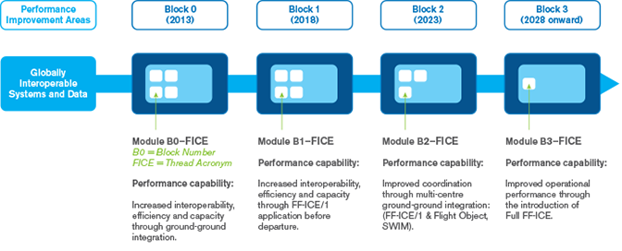
The future: the ASBU FICE
OLDI
FICE (FIXM/IOP)
AIDC

Slide 31

The future: the ASBU FICE
Supports the coordination of ground-ground data communication between ATSU based on:
Introduction of FICE step 1, to implement ground-ground exchanges using:
Improved Coordination through multi-centre Ground-Ground Integration:
Air-Ground Integration
FF-ICE
Trajectory-based operations
Multicentre operations
Flight object
IOP standards
FIXM
Flight object before departure
AIDC/OLDI
Network
Network
Network

Slide 32
The future
FFICE will progressively widen the horizon to new stakeholders:
  ATM service providers,
  airspace users operations
  airport operations
Will rely on
  Trajectory-based operations
  Multicentre operations
  Use of Flight object, IOP standards

Slide 33
Trajectory-based operations
Definition of a new object shared by all stakeholders: the trajectory
  SBT: Shared Business Trajectory
  RBT: Reference Business Trajectory
  The trajectory is published and amended during planning and execution phases
Trajectory-based
  OLDI/AIDC: only locally updated trajectory information (possibly updated by surveillance data)
  4D Trajectories handled/refined dynamically as a whole, involving multiple operators, from planning (several months before the flight) to execution phases
  Downstream constraints application: downstream ATSUs will apply hierarchized constraints within a far look-ahead period (support of what if/what else tools) and RBT will be updated as a result of the negotiation
B1 NOPS: enhanced processes to manage flows or groups of flights in order to improve overall flow
  User driven prioritization process (UDPP): airspace users will publish their preferred profile, and ATC will facilitate
  Network planners will interact with the trajectory
  Airspace managed more and more dynamically
B1-FICE definition will allow information sharing, trajectory or slot negotiation
FIXM will enable CDM, A-CDM, ANSP to ANSP boundary crossing, 4D trajectories exchanges between ICAO regions and with airlines
  Data format, exchange model for the Flight domain part of SWIM (AIXM: aeronautical information and WXXM: weather)
  FIXM formatted data to be exchanged between regions and with airspace users

Slide 34
Use of Flight object
During execution phase, ATM service providers, airspace users and airports will update RBT
Standardization of RBT will take into account the Flight Object (F.O.) interoperability specification defined by Eurocae Document 133
F.O. interoperability specification covers:
  Notification, coordination and transfer of flights between air traffic control units
  MTCD across system boundaries.
  The distribution of time constraints from AMAN applications
  Negotiation of route amendments with downstream units
  CIVIL/CIVIL coordination (CIVIL/MIL is not explicitly covered but can be managed)
ED-133 defines
  Flight data common reference
  Format: a set of XML schemas
  architecture of Flight Object Servers
  a set of services to be offered, and the payload they carry
To date
  ATC-ATC interactions defined (B1 FICE)
  ATC-Network interactions studied under SESAR project (B1 and B2 FICE)
  airspace users considered later on (B3 FICE)
Standardization between FIXM and Flight Object is currently being addressed

Slide 35
Multicentre operations
IOP will rely on a real time full synchronization of all Flight Data Processing Systems of the IOP area, including ATFCM/Network
OLDI/AIDC: point to point synchronization between upstream and downstream ATSU

Slide 36
Trajectory management: perspective
4D TRAD
Air-Ground IOP
B3-FICE
Network
via ADS-C
Trajectory Management
Traffic Synchronisation i4D, CTA, AMAN, XMAN
Ground ATC - ATFCM IOP
IOP FOS
Network Mngt before departure
RTA ETA min-max
SWIM Services
FO (SBT)
Regional
Network
B1-FICE
FIXM
FO (RBT)
B2-FICE
Flight Object
Ground Ground multi ATSU IOP
CDM
Notes:
Ground ATC-ATFCM
Centralised 4D Trajectory profile calculation
for all ATM planning activities
Ground ground muti ATSU
Seamless coord & transfer
Separation assurance
Conflict mngt
Metering
4D
- Trajectory downlink
- Trajectory negotiation
- Time/speed constraint negotiation
-Monitoring and trajectory updates

Slide 37
Trajectory management: perspective
Standardization of a new concept of trajectory management in progress
Will supersede both AIDC and OLDI standards
Progressive implementation by ANSPs and industry will start from Block 1 (around 2020)
  Transition will probably take a long time (maturation of standards, impacts heart of the systems, multi-actors, multi-organizations)
Meanwhile any standardization of a PAN OLDI/AIDC ICD would involve costly system upgrades, out of the path to FF-ICE

Slide 38
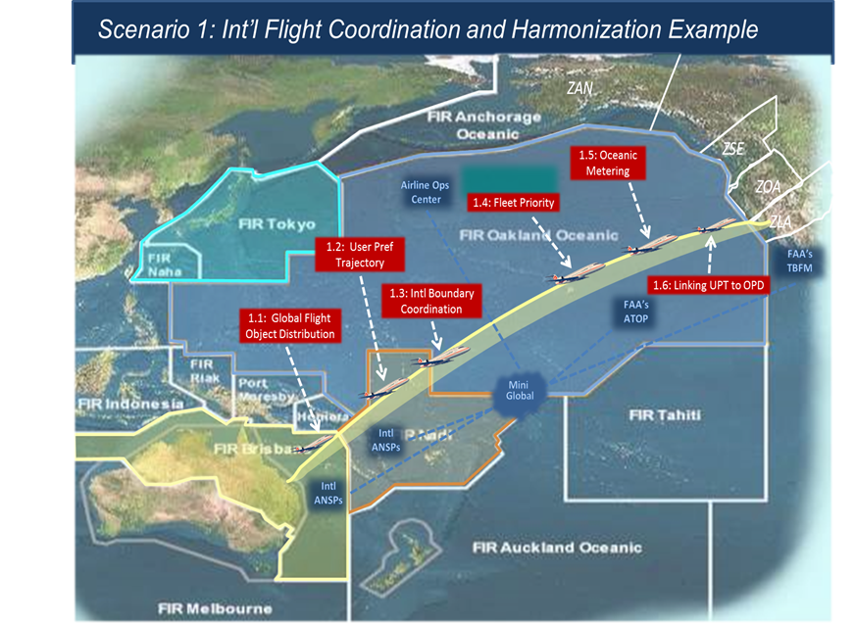
Mini global demonstration
September 14
FAA, CAAS, JCAB, Nav Canada, MOLIT (Republic of Korea), AEROTHAI, Airservices Australia, Nav Portugal, Indra, Delta
  Demonstrate the use of SWIM between ANSP to promote more efficient operations across multiple FIRs
  Support the validation of ICAO FF-ICE
Mini Global II: 2014-2016

Slide 39
Conclusion

Slide 40
Conclusion
Implementation cases through the world seem far from using all possibilities of the standards
  ANSP opt for bilaterally agreed subset of messages, and at times inclusion/interpretation of (optional) fields in line with their operational needs
Yet lessons learnt show that implementing at least a minimum message set reduces frequency of LHD occurrences and alleviates ATCO workload
A short term objective should target this minimum message set
A longer term objective should target the comprehensive set of AIDC messages in line with the OPS needs

Slide 41
Conclusion
Instead of a PAN AIDC/OLDI ICD, the way forward is to progress towards a common concept: the ICAO Flight and Flow Information for a Collaborative Environment (FF-ICE) concept,
  ASBU B0/B1/B2
  taken on board SESAR and Nextgen,
  according to the Global Air Traffic Management Operational Concept Doc 9854
  Mini GLOBAL demonstration

Slide 42
References
ICAO Annex 10, volume II
ICAO Doc 4444 PANS ATM
ICAO Manual of Technical Provisions for the Aeronautical Telecommunication Network (ATN) (Doc 9705), Sub-volume III
ICAO Doc 9750, Global Air Navigation Plan, 4th Edition - 2013
ICAO Pan Regional (NAT and APAC) Interface Control Document for ATS Interfacility Data Communications (PAN ICD), Coordination Draft Version 0.92 — August, 2014
APAC Seamless plan v1.0, June 2013
Guidance Material for the Asia/Pacific Region for ADS/CPDLC/AIDC
EUROCONTROL Specification for On-Line Data Interchange (OLDI) Edition 4.2, 16/12/2010
EUROCONTROL Corrigendum to Edition 4.2, 16/12/2010
Eurocae ED-133 Flight Object interoperability specification, June 2009
FIXM: www.FIXM.aero

Slide 43
ACRONYMS
APAC: Asia-Pacific
ATS: Air Traffic Services
AIDC: ATS Interfacility Data Communication
AIM: Aeronautical Information Management
AIXM: Aeronautical Information eXchange Model
ATCO: Air Traffic Controller
EUR: Europe
FIR: Flight information region
FIXM: Flight Information eXchange Model
FO: Flight Object
GANP: Global Air Navigation Plan
ICAO: International Civil Aviation Organisation
ICC: Inter-centre communications
ICD: Interface Control Document
LHD: Large Height Deviation
NAT: North Atlantic
NextGen: Next Generation Air Transportation System
SESAR: Single European Sky ATM Research
SWIM: System Wide information Management
WXXM: Weather eXchange Model

